Slide 1
SEZG651/ SSZG653 Software Architectures Module 4 CS06 Documenting Software Architecture Structures and Views

Slide 2
Architectural Structures and Views
Harvinder S Jabbal
SSZG653 Software Architectures

Slide 3
SEZG651/ SSZG653
Software Architectures
Module 4 -CS 06/1

Slide 4
Structure & View

Slide 5
Structure & View
A view is a representation of a coherent set of architectural elements, as written by and read by system stakeholders.
It consists of a representation of a set of elements and the relations among them.
A structure is the set of elements itself, as they exist in software or hardware.

Slide 6
example
A module structure is the set of the system's modules and their organization.
A module view is the representation of that structure, as documented by and used by some system stakeholders.
These terms are often used interchangeably, but we will adhere to these definitions.

Slide 7
Architectural structures

Slide 8
Module structures.
Here the elements are modules, which are units of implementation.
Modules represent a code-based way of considering the system.
They are assigned areas of functional responsibility.
There is less emphasis on how the resulting software manifests itself at runtime.
Module structures allow us to answer questions such as
What is the primary functional responsibility assigned to each module?
What other software elements is a module allowed to use?
What other software does it actually use?
What modules are related to other modules by generalization or specialization (i.e., inheritance) relationships?

Slide 9
Component-and-connector structures.
Here the elements are
runtime components (which are the principal units of computation) and
connectors (which are the communication vehicles among components).
Component-and-connector structures help answer questions such as
What are the major executing components and how do they interact?
What are the major shared data stores?
Which parts of the system are replicated?
How does data progress through the system?
What parts of the system can run in parallel?
How can the system's structure change as it executes?

Slide 10
Allocation structures.
Allocation structures show the relationship between
the software elements and
the elements in one or more external environments in which the software is created and executed.
They answer questions such as
What processor does each software element execute on?
In what files is each element stored during development, testing, and system building?
What is the assignment of software elements to development teams?

Slide 11
architectural design

Slide 12
3 structures
3 broad decision types
How is the system to be structured as a set of code units (modules)?
How is the system to be structured as a set of elements that have
runtime behavior (components) and
interactions (connectors)?
How is the system to relate to nonsoftware structures in its environment
(i.e., CPUs, file systems, networks, development teams, etc.)?

Slide 13
SOFTWARE STRUCTURES

Slide 14
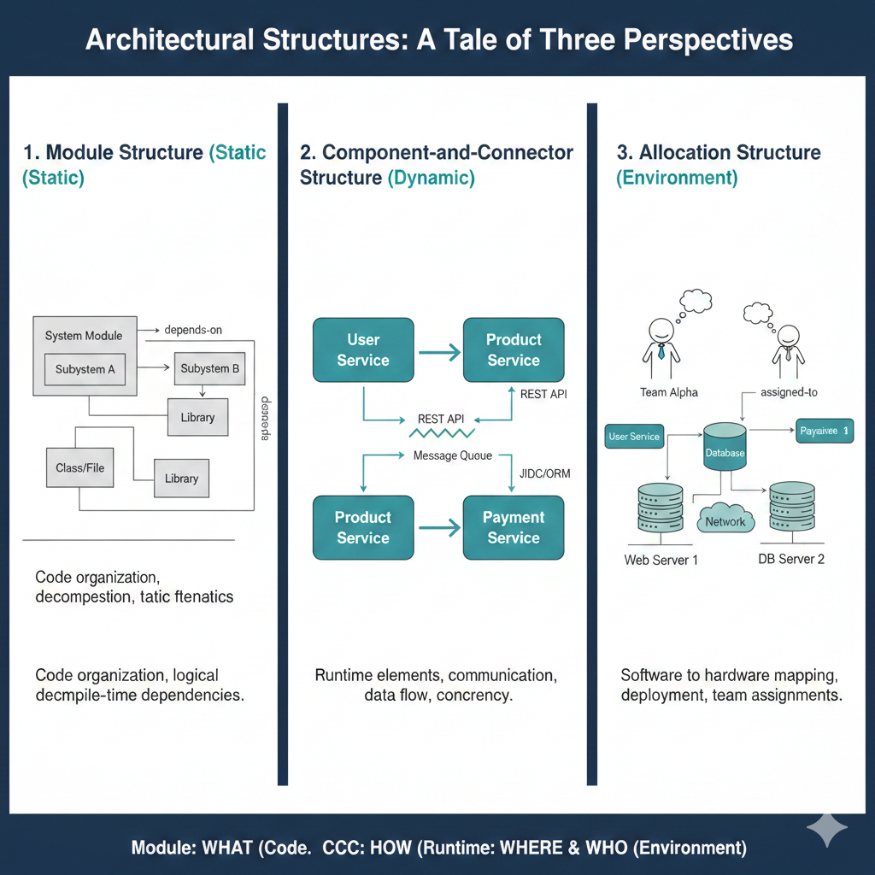
3 Perspectives

Slide 15
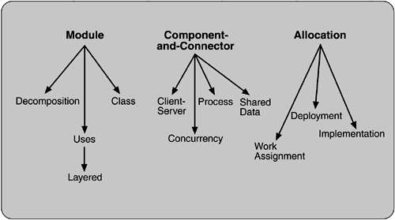
SOFTWARE STRUCTURES

Slide 16
Module

Slide 17
Decomposition.
The units are modules related to each other by the "is a submodule of " relation, showing how larger modules are decomposed into smaller ones recursively until they are small enough to be easily understood.
Modules in this structure represent a common starting point for design, as the architect enumerates what the units of software will have to do and assigns each item to a module for subsequent (more detailed) design and eventual implementation.
Modules often have associated products (i.e., interface specifications, code, test plans, etc.).
The decomposition structure provides a large part of the system's modifiability, by ensuring that likely changes fall within the purview of at most a few small modules.
It is often used as the basis for the development project's organization, including the structure of the documentation, and its integration and test plans. The units in this structure often have organization-specific names.
Certain U.S. Department of Defense standards, for instance, define Computer Software Configuration Items (CSCIs) and Computer Software Components (CSCs), which are units of modular decomposition.

Slide 18
Uses.
The units of this important but overlooked structure are also modules, or (in circumstances where a finer grain is warranted) procedures or resources on the interfaces of modules.
The units are related by the uses relation.
One unit uses another if the correctness of the first requires the presence of a correct version (as opposed to a stub) of the second.
The uses structure is used to engineer systems that can be easily extended to add functionality or from which useful functional subsets can be easily extracted.
The ability to easily subset a working system allows for incremental development.

Slide 19
Layered.
When the uses relations in this structure are carefully controlled in a particular way, a system of layers emerges, in which a layer is a coherent set of related functionality.
In a strictly layered structure, layer n may only use the services of layer n - 1.
Many variations of this (and a lessening of this structural restriction) occur in practice, however.
Layers are often designed as abstractions (virtual machines) that hide implementation specifics below from the layers above, engendering portability.

Slide 20
Class, or generalization.
The module units in this structure are called classes.
The relation is "inherits-from" or "is-an-instance-of."
This view supports reasoning about collections of similar behavior or capability (i.e., the classes that other classes inherit from) and parameterized differences which are captured by subclassing.
The class structure allows us to reason about re-use and the incremental addition of functionality.

Slide 21
Component and Connector

Slide 22
Process, or communicating processes.
Like all component-and-connector structures, this one is orthogonal to the module-based structures and deals with the dynamic aspects of a running system.
The units here are processes or threads that are connected with each other by communication, synchronization, and/or exclusion operations.
The relation in this (and in all component-and-connector structures) is attachment, showing how the components and connectors are hooked together.
The process structure is important in helping to engineer a system's execution performance and availability.

Slide 23
Concurrency.
This component-and-connector structure allows the architect to determine opportunities for parallelism and the locations where resource contention may occur.
The units are components and the connectors are "logical threads."
A logical thread is a sequence of computation that can be allocated to a separate physical thread later in the design process.
The concurrency structure is used early in design to identify the requirements for managing the issues associated with concurrent execution.

Slide 24
Shared data, or repository.
This structure comprises components and connectors that create, store, and access persistent data.
If the system is in fact structured around one or more shared data repositories, this structure is a good one to illuminate.
It shows how data is produced and consumed by runtime software elements, and it can be used to ensure good performance and data integrity.

Slide 25
Client-server.
If the system is built as a group of cooperating clients and servers, this is a good component-and-connector structure to illuminate.
The components are the clients and servers, and the connectors are protocols and messages they share to carry out the system's work.
This is useful for separation of concerns (supporting modifiability), for physical distribution, and for load balancing (supporting runtime performance).

Slide 26
Allocation

Slide 27
Deployment.
The deployment structure shows how software is assigned to hardware-processing and communication elements.
The elements are software (usually a process from a component-and-connector view), hardware entities (processors), and communication pathways.
Relations are "allocated-to," showing on which physical units the software elements reside, and "migrates-to," if the allocation is dynamic.
This view allows an engineer to reason about performance, data integrity, availability, and security.
It is of particular interest in distributed or parallel systems.

Slide 28
Implementation.
This structure shows how software elements (usually modules) are mapped to the file structure(s) in the system's development, integration, or configuration control environments.
This is critical for the management of development activities and build processes.

Slide 29
Work assignment.
This structure assigns responsibility for implementing and integrating the modules to the appropriate development teams.
Having a work assignment structure as part of the architecture makes it clear that the decision about who does the work has architectural as well as management implications.
The architect will know the expertise required on each team.
Also, on large multi-sourced distributed development projects, the work assignment structure is the means for calling out units of functional commonality and assigning them to a single team, rather than having them implemented by everyone who needs them.

Slide 30
elements and relations in each structure
Software Structure | Relations | Useful for
Decomposition | Is a submodule of; shares secret with | Resource allocation and project structuring and planning; information hiding, encapsulation; configuration control
Uses | Requires the correct presence of | Engineering subsets; engineering extensions
Layered | Requires the correct presence of; uses the services of; provides abstraction to | Incremental development; implementing systems on top of "virtual machines" portability
Class | Is an instance of; shares access methods of | In object-oriented design systems, producing rapid almost-alike implementations from a common template

Slide 31
elements and relations in each structure
Software Structure | Relations | Useful for
Client-Server | Communicates with; depends on | Distributed operation; separation of concerns; performance analysis; load balancing
Process | Runs concurrently with; may run concurrently with; excludes; precedes; etc. | Scheduling analysis; performance analysis
Concurrency | Runs on the same logical thread | Identifying locations where resource contention exists, where threads may fork, join, be created or be killed
Shared Data | Produces data; consumes data | Performance; data integrity; modifiability

Slide 32
elements and relations in each structure
Software Structure | Relations | Useful for
Deployment | Allocated to; migrates to | Performance, availability, security analysis
Implementation | Stored in | Configuration control, integration, test activities
Work Assignment | Assigned to | Project management, best use of expertise, management of commonality

Slide 33
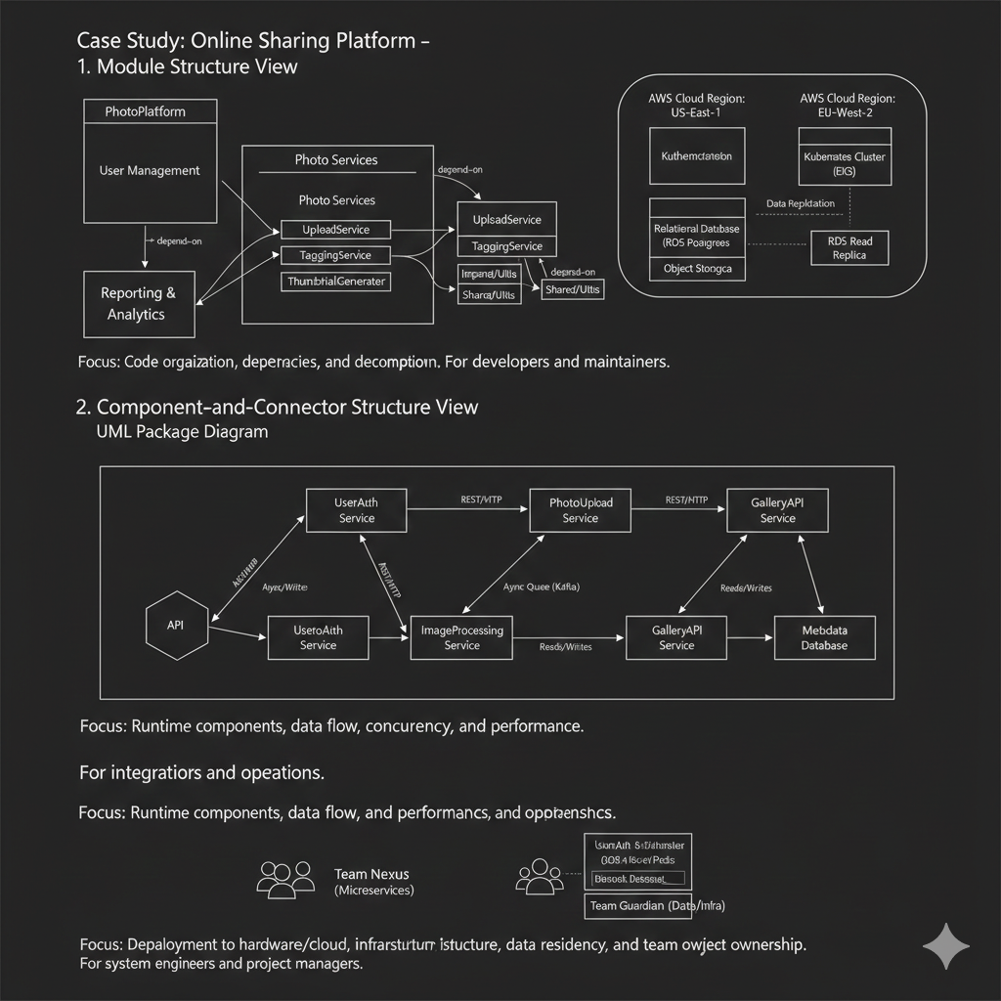
Case Study

Slide 34
Kruchten's four views

Slide 35
WHICH STRUCTURES TO CHOOSE?
Logical.
The elements are "key abstractions," which are manifested in the object-oriented world as objects or object classes. This is a module view.
Process.
This view addresses concurrency and distribution of functionality. It is a component-and-connector view.
Development.
This view shows the organization of software modules, libraries, subsystems, and units of development. It is an allocation view, mapping software to the development environment.
Physical.
This view maps other elements onto processing and communication nodes and is also an allocation view (which others call the deployment view).

Slide 36
Documenting Architecture Views
Harvinder S Jabbal
SSZG653 Software Architectures

Slide 37
SEZG651/ SSZG653
Software Architectures
Module 4-CS 06/2

Slide 38
Architecture Views

Slide 39
Views
Representation of a coherent set of architectural elements , as written by and read by system stakeholders.

Slide 40
Documenting
“Documenting an architecture is a matter of documenting the relevant views and then adding a documentation that applies to more than one view.”

Slide 41
Solution to a Problem
Problem
Architecture documents do not address the concerns of all stakeholders .
Deferent Stakeholders : end-user, system engineers, developers and project managers.
Architecture documents contained complex diagrams some times they are hard to be represented on the documentation.
Solution
Using different notations for several Views each one addressing one specific set for concerns.

Slide 42
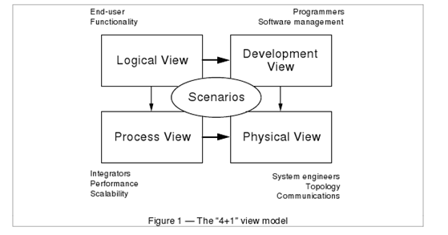
4+1 Model -
Philippe Kruchten, Rational Software Corp.

Slide 43
Logical View
• The logical view, which is the object model of the design (when an object-oriented design method is used)
Viewer: End-user
considers: Functional requirements- What are the services must be provided by the system to the users.
Notation: The Booch notation .
Tool: Rational Rose

Slide 44
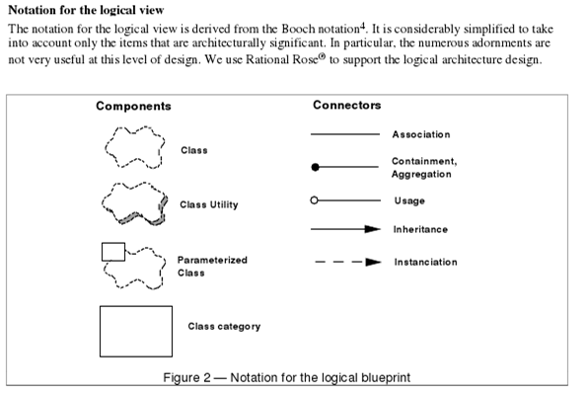
Notation for Logical View-
Philippe Kruchten, Rational Software Corp.

Slide 45
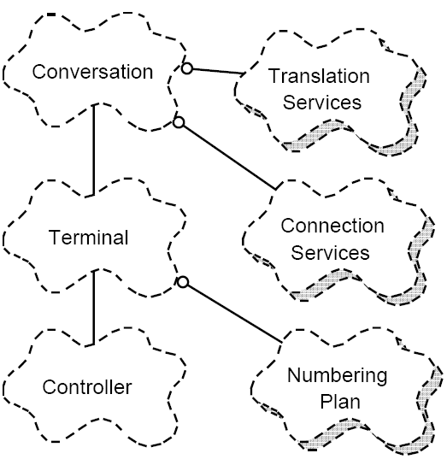
Logical view Example PABX-
Philippe Kruchten, Rational Software Corp.

Slide 46
Process View
The process view, which captures the concurrency and synchronization aspects of the design(The process decomposition).
viewer: Integrators
considers: Non - functional requirements (scalability, concurrency, and performance)
style: Garlan and Shaw ‘s Architecture styles.

Slide 47
Process (cont.)
Uses multiple levels of abstractions.
A process is a grouping of tasks that form an executable unit:
Major Tasks: Architecture relevant tasks.
Minor or helper Tasks: (Buffering)

Slide 48
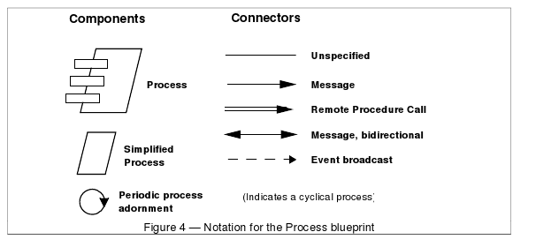
Notation-
Philippe Kruchten, Rational Software Corp.

Slide 49
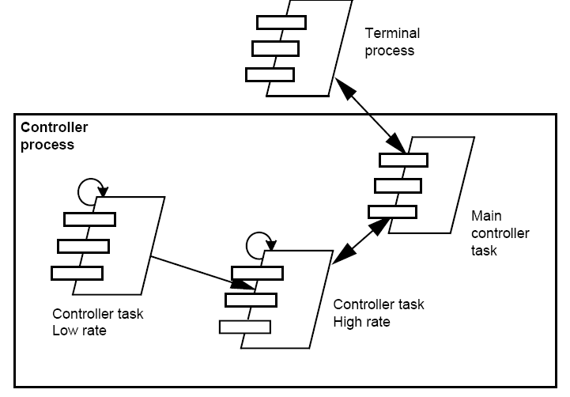
Process View example PABX (partial)-
Philippe Kruchten, Rational Software Corp.

Slide 50
Development View
The development view, which describes the static organization of the software in its development environment.
Viewer: Programmers and Software Managers
considers: software module organization. (Hierarchy of layers, software management, reuse, constraints of tools).
Notation: the Booch notation.
Style: layered style

Slide 51
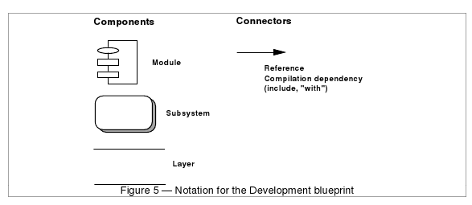
Notation for Development blueprint-
Philippe Kruchten, Rational Software Corp.

Slide 52
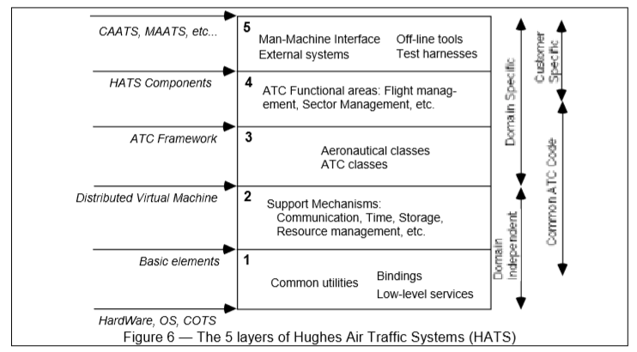
Development View – Layered Style
Philippe Kruchten, Rational Software Corp.

Slide 53
Physical View
the physical view, which describes the mapping(s) of the software onto the hardware and reflects its distributed aspect.
Viewer: System Engineers
Considers: Non-functional requirement (reliability, availability and performance). regarding to underlying hardware.
There may be two architecture:
Test and development
deployment

Slide 54
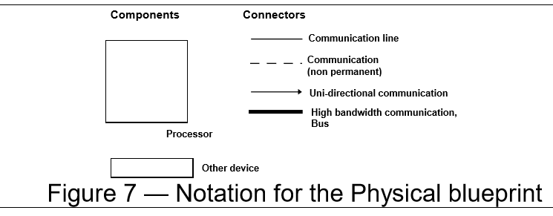
Notation for Physical view-
Philippe Kruchten, Rational Software Corp.

Slide 55
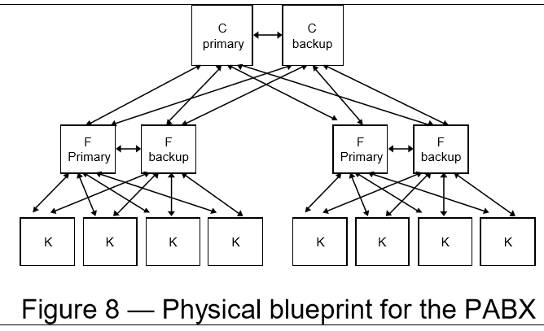
Physical blueprint PABX-
Philippe Kruchten, Rational Software Corp. (PHYSICAL AUTOMATIC BRANCH EXCHANGE)

Slide 56
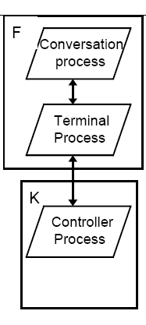
Physical view example-
Philippe Kruchten, Rational Software Corp.
A small PABX physical architecture with process allocation.

Slide 57
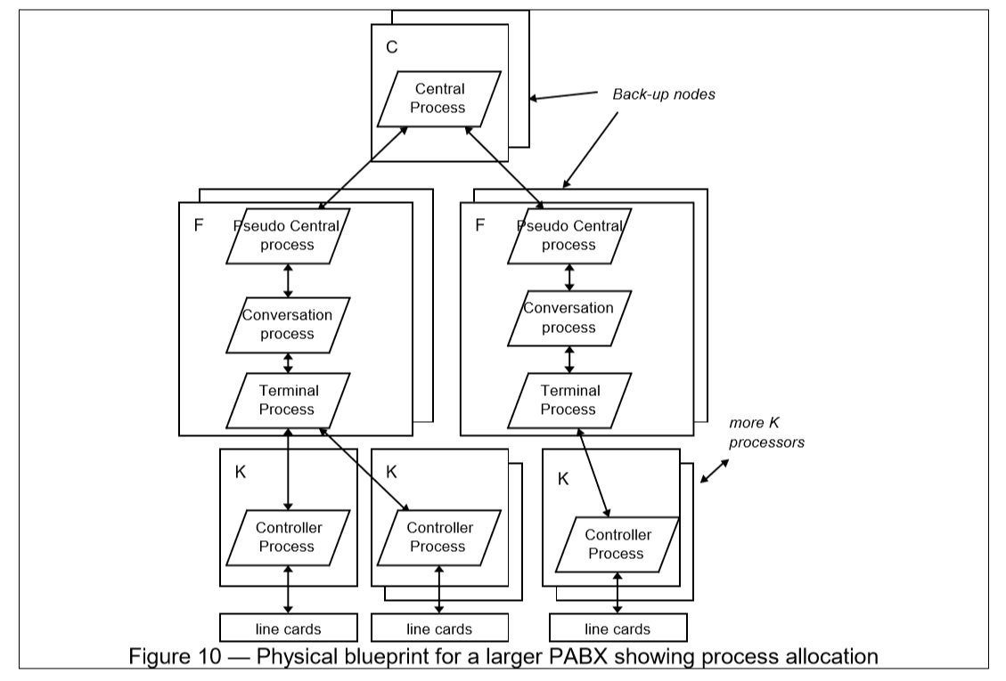
Physical view example-
Philippe Kruchten, Rational Software Corp.

Slide 58
Scenarios
(Putting all “4 views” together)
Viewer: All users and Evaluators.
Considers: System consistency and validity
Notation: Similar to logical view

Slide 59
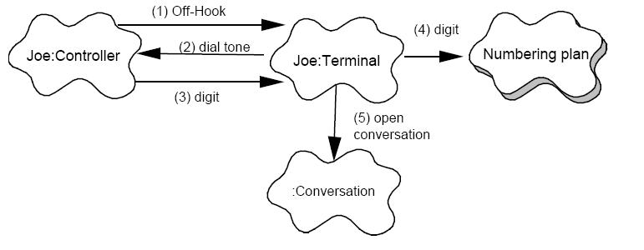
Scenario example-
Philippe Kruchten, Rational Software Corp.
Scenario for a Local call – selection phase

Slide 60
Correspondence between the views
The views are interconnected.
Start with Logical view and Move to Development / Process view and then finally go to Physical view.

Slide 61
From logical to Process view
Two strategies :
Inside-out: starting from Logical structure
Outside-in: starting from physical structure

Slide 62
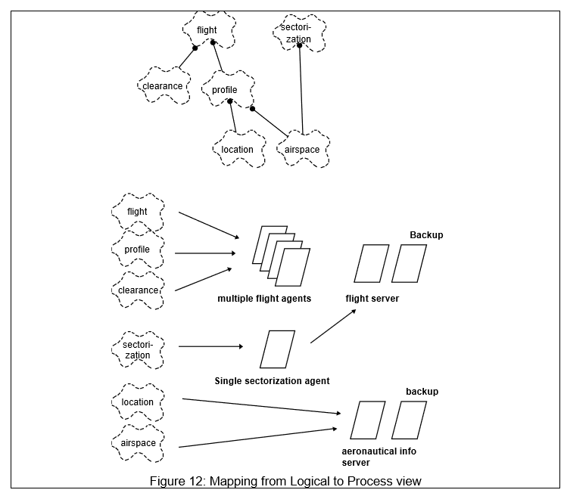
From logical to Process view

Slide 63
From Logical to development
They are very close, but the larger the project, the greater the distance between these views.
Grouping to subsystems depending on:
The team organization.
The class categories which includes the packages.
The Line of codes.

Slide 64
Iterative process
Not all architectures need all views.
A scenario-driven approach to develop the system is used to handle the iterative.
Documenting the architecture:
Software architecture document: follows closely “4+1” views.
Software design guidelines: it captured the most important design decisions that must be respected to maintain the architectural integrity.

Slide 65
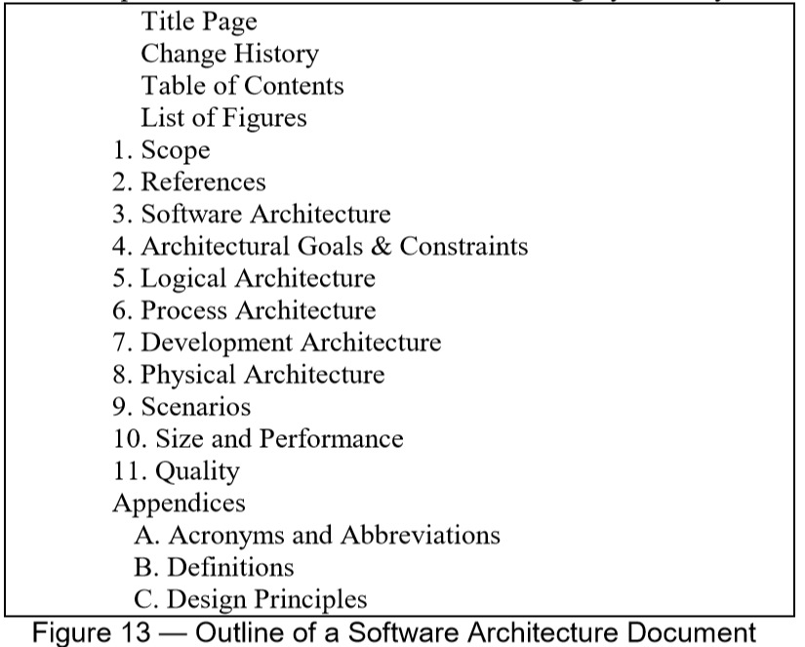
Software Design Document

Slide 66
Annotation:
“4+1 views” methodology successfully used in the industry
Air Traffic Control
Telecom
This paper missing the tools to integrate these views which lead to an inconsistency problem.
The inconsistency problem is more tangible in the maintenance of the architecture.

Slide 67
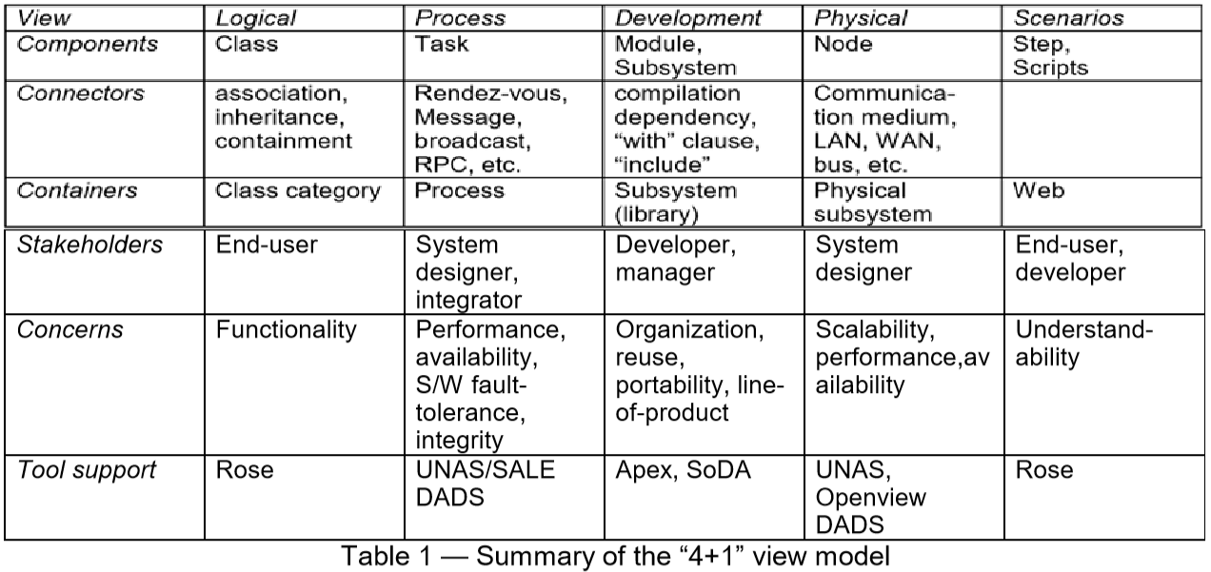
Summary

Slide 68
Synthesis: Mapping SEI Structures to 4+1 Views
Content: While the terminology differs, the underlying architectural intent is the same. Understanding this mapping prevents "documentation silo
SEI Structure Category | Kruchten 4+1 View | Primary Focus
Module | Logical View | Functional decomposition, classes, and layers.
Component & Connector | Process View | Runtime behavior, throughput, and scalability.
Allocation | Development View | Mapping software to the file system/CM environment.
Allocation | Physical View | Mapping software to hardware/cloud nodes.
Key takeaway: Use SEI definitions for what to document, and 4+1 for who (stakeholders) you are documenting for.

Slide 69
Modernizing the Logical View
Logical View: Beyond Booch to UML 2.5 Content:
The Shift: While the original 4+1 papers used Booch notation, modern architecture uses UML (Unified Modeling Language).
Key Diagrams to Include:
Class Diagrams: To show static relationships and "is-a" hierarchies.
Package Diagrams: To show high-level module grouping and encapsulation.
Modern Context: In a Microservices world, the Logical View defines the Service API contracts and domain boundaries (Bounded Contexts).

Slide 70
The Evolution of the Process View
Process View: Concurrency in the Cloud Era Content:
From PABX to Microservices: Modern components are often independent containers (Docker) or Serverless functions (Lambda).
Dynamic Behavior: * Sequence Diagrams: Essential for showing how components exchange messages over time.
Activity Diagrams: To model complex business workflows and parallel processing.
Concerns: Focus on latency, deadlocks, and "Eventual Consistency" in distributed systems.

Slide 71
Development View & Modern Tooling
Development View: The "Build" Environment Content:
Scope: This view must now account for DevOps and CI/CD pipelines.
Key Elements:
Repository Structure: Monorepo vs. Multi-repo strategies.
Third-party Dependencies: Managing NuGet/NPM/Maven packages.
Stakeholders: Primarily for Developers and Build Engineers to ensure the system is "buildable" and "testable."

Slide 72
Physical View: Hardware to Infrastructure as Code (IaC)
Physical View: Deployment in the 2020s Content:
The Virtualized Reality: Physical nodes are rarely "bare metal" today; they are Virtual Machines (VMs) or Clusters (Kubernetes).
Key Concepts:
Elasticity: How the architecture scales up/down automatically.
Network Topologies: Firewalls, API Gateways, and Load Balancers.
Documentation Tool: Use Deployment Diagrams to map software artifacts to execution environments.

Slide 73
Maintaining Architectural Integrity
The Challenge of Architectural Drift Content:
The Problem: Over time, the code (Implementation) evolves faster than the documentation (Views). This is known as Architectural Drift.
The Solution:
Architecture as Code: Using tools like Mermaid.js or PlantUML to keep diagrams in the same Git repo as the code.
Automated Checks: Using "fitness functions" to ensure code dependencies don't violate the Layered structure defined in the Module View.
Goal: The architecture should be a "living document," not a static PDF.

Slide 74
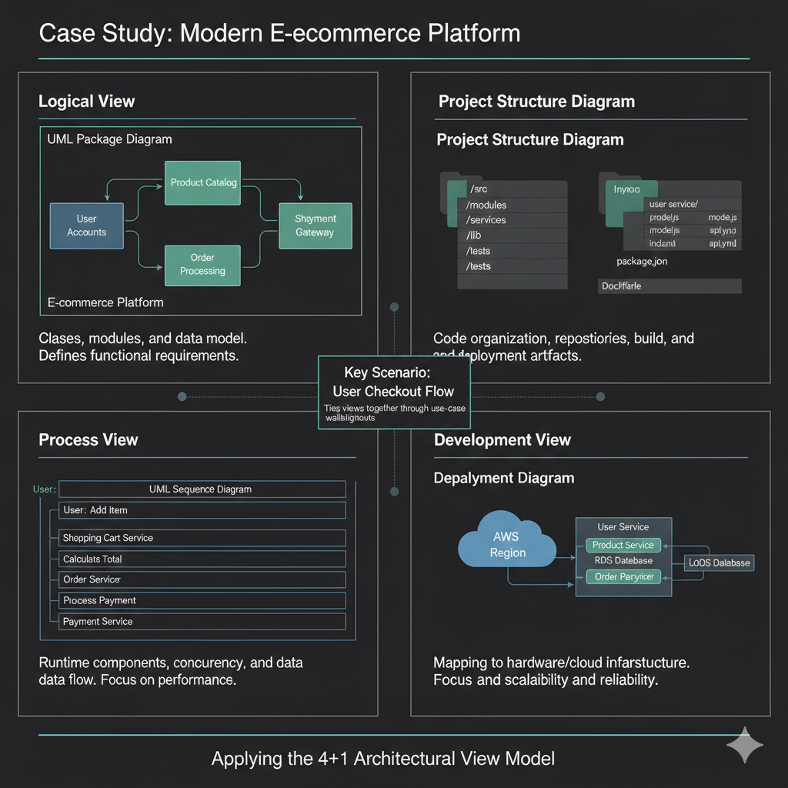
CASE STUDY

Slide 75
Summary & Stakeholder Mapping
Summary: Choosing the Right View Content: Not every project needs every view. Use this guide to prioritize:
Building a complex UI? Prioritize the Logical View.
High-performance/High-traffic? Prioritize the Process View.
Large, distributed team? Prioritize the Development View.
Cloud-native/Complex security? Prioritize the Physical View.
Conclusion: Document only what is necessary to communicate the design and mitigate risk.

